Slide 1

Customer Shopping Behavior Analysis
Analyzing 3,900 customer transactions to uncover spending patterns, preferences, and strategic opportunities across product categories and customer segments.

Slide 2

Dataset Overview
3,900
18
50
$60
Total Purchases
Data Features
Locations
Avg Purchase
Transactions analyzed across all categories
Comprehensive customer and purchase attributes
Geographic diversity in customer base
Mean transaction value across all customers
Key features include customer demographics, purchase details, shopping behavior patterns, and subscription status. Missing data limited to 37 values in Review Rating column.

Slide 3

Data Preparation & Engineering
Python Analysis Pipeline
Key Statistics
Loaded dataset using pandas for exploration
Age Range: 18-70 years (mean: 44)
Purchase Range: $20-$100
Imputed missing Review Ratings with category medians
Review Rating: 2.5-5.0 (mean: 3.75)
Standardized columns to snake case format
Previous Purchases: 1-50 transactions
Created age_group and purchase_frequency_days features
Gender Split: 68% Male, 32% Female
Integrated cleaned data into PostgreSQL database

Slide 4

Revenue Insights
Gender Revenue Gap
Age Group Performance
Shipping Premium
Male customers generated $157,890 vs. Female customers at $75,191 - revealing significant targeting opportunities.
Young Adults lead with $62,143 revenue, followed by Middle-aged ($59,197), Adults ($55,978), and Seniors ($55,763).
Express shipping users spend $60.48 on average vs. $58.46 for Standard - indicating willingness to pay more.

Slide 5
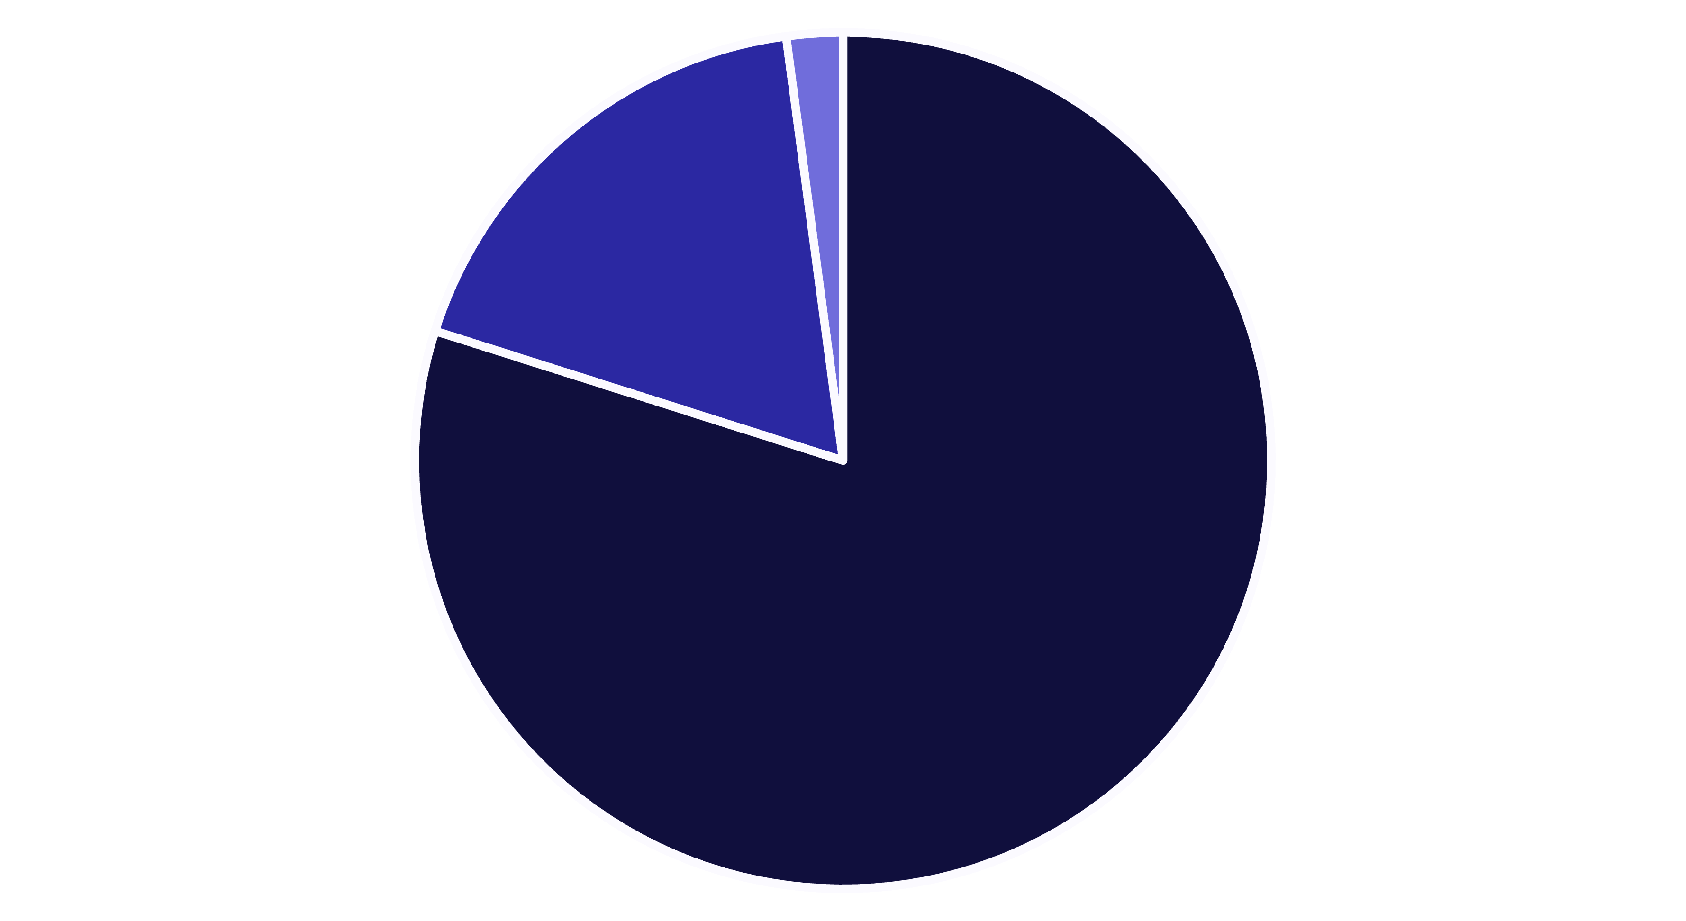
Customer Segmentation
Loyal
Returning
New
Loyal customers dominate at 80% of the base, with 958 repeat buyers (>5 purchases) showing subscription interest. Only 2.1% are new customers, suggesting strong retention but limited acquisition.

Slide 6


Product Performance Analysis
Top Rated: Gloves
Clothing Leader: Blouse
Most Popular: Jewelry
Highest average rating at 3.86 stars
171 orders dominate Clothing segment
171 orders lead Accessories category
50%
49.7%
Hat Discount Rate
Sneakers Discounts
Highest discount dependency
Nearly half sold with promotions

Slide 7

Subscription & Discount Dynamics
Subscription Status
Smart Discount Users
Subscribers: 1,053 customers
839 customers used discounts but still spent above the $60 average purchase amount, demonstrating that promotions don't always reduce transaction value.
Average Spend: $59.49
Total Revenue: $62,645
Non-Subscribers: 2,847 customers
This suggests strategic discount targeting can drive volume without sacrificing revenue per customer.
Average Spend: $59.87
Total Revenue: $170,436

Slide 8





Strategic Recommendations
Boost Subscription Value
Promote exclusive benefits to convert non-subscribers who represent 73% of customers but similar spending patterns.
Loyalty Program Enhancement
Reward repeat buyers to accelerate movement from Returning (18%) to Loyal (80%) segments.
Optimize Discount Strategy
Balance promotional sales with margin control, focusing on products with 45%+ discount dependency.
Targeted Marketing
Focus campaigns on Young Adults and express-shipping users who show higher engagement and spending willingness.

